Slide 1
GEOGRAPHICAL INFORMATION SYSTEM

Slide 2
CONTENT
Introduction
Definition of GIS
Why we used GIS ?
Components of GIS
Geographical Data
Types and characteristics of Geographical Data
Application Areas of GIS

Slide 3
INTRODUCTION
A geographic information system (GIS) is A computer system for capturing, storing, analyzing, and displaying data that is spatially referenced to the earth. GIS can be used to create maps, analyze patterns of the geographical elements, and identify relationships. It is A powerful tool that can be used for A variety of purposes.

Slide 4
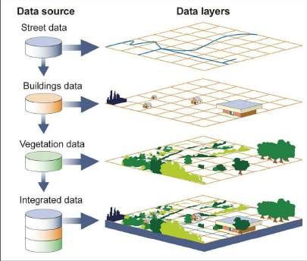
DEFINITION OF GIS
GIS is define as the process of collecting geographical data, Storing ,Manipulating, Analyzing , as well as provide a output result of the real world

Slide 5
Why we used GIS ?
We use GIS (Geographic Information System) for many reasons. Here are some of the most common ones:
To visualize data: GIS can be used to create maps and charts that help us visualize data in a way that is easy to understand. This can be helpful for understanding patterns, trends, and relationships in data.
To analyze data: GIS can be used to perform spatial analysis on data. This can help us to understand how diﬀerent variables are related to each other in space. For example, we can use GIS to analyze the relationship between crime rates and poverty rates in a city.
To manage data: GIS can be used to store, organize, and manage large amounts of data. This can be helpful for businesses, governments, and other organizations that need to track and analyze large amounts of data.
To make decisions: GIS can be used to support decision making by providing us with insights into spatial data. For example, a city planner can use GIS to identify areas that are most in need of new parks or schools.

Slide 6
COMPONENTS OF GIS
Hardware : Hardware is the computer system on which the GIS software runs. It can range from a desktop
computer to a powerful server farm. The hardware is basically physical part of the computer.
Software: Software is the programs that allow users to create, store, manage, analyze, and visualize geographic data. There are many diﬀerent GIS software packages available, each with its own strengths and weaknesses.
Data: Data is the heart of a GIS. It can include spatial data (such as maps and satellite images), attribute data (such as land use data or population data), and metadata (information about data)
User: User are the ones who use GIS to solve problems and make decisions. They need to have the skills to collect, manage, and analyze data, as well as the ability to communicate their findings to others.
Methods: Methods are the techniques that are used to analyze and visualize geographic data. These methods can range from simple queries to complex spatial analysis.

Slide 7
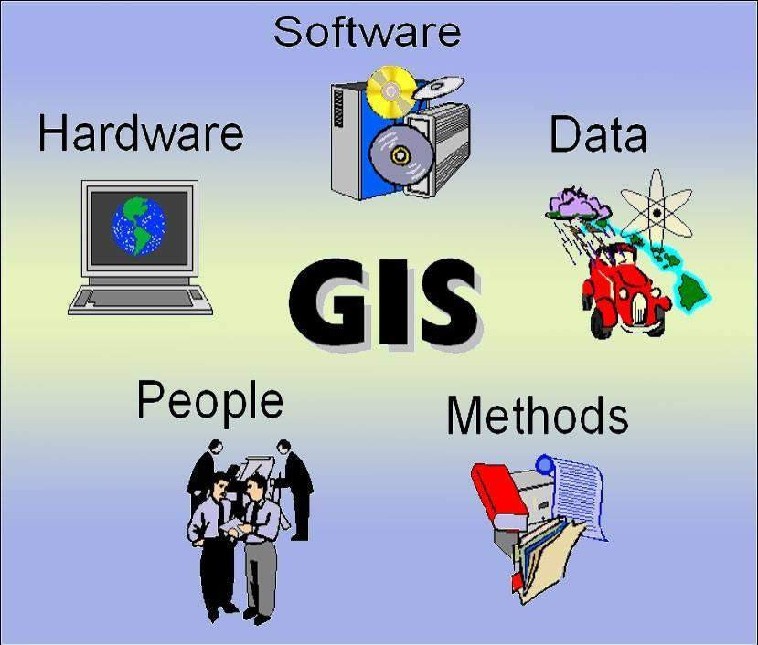

Slide 8
Geographic data:
Geographic data, also known as geospatial data or GIS data ,it is data that has a location on Earth. It can be used to represent features of the Earth's surface, such as roads, buildings, rivers, and lakes. It can also be used to represent information about these features, such as their names, types, and attributes.
The three types of GIS Data are
Spatial
Attribute Data or Non-Spatial Data
Metadata
In the next slide we wall briefly discuss about those three type of data…..

Slide 9
Spatial Data: spatial Data can be define as the data which is used to represent the locational information of the Earth Surface.
We all know that the Spatial data may be in different types two types such as
Vector Data Raster Data TIN
Images
□ Vector data:
Vector data is define as spatial data in GIS. A vector data can be represented by point, line as well as polygon also.
Points Data: point data represented the location of any geographical element such as location of a building, location of a tree, location of an ATM etc.
Line Data: The line data used to represented the linear geographical features of the earth surface such as River, transport system and any kind of linear features.
Polygon Data: The polygon data used to represented the area of any geographical features such as Administrative boundary, Soil types etc.

Slide 10
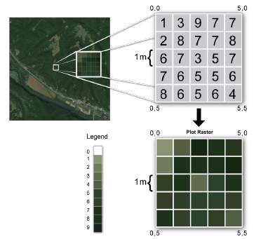
Raster Data
The raster data can be define as the data which consists
of a matrix of cells (or pixels) organized into rows and columns (or grid) where each cell contains a particular value (DN value) representing information such as elevation, temperature are known as Raster data.

Slide 11
Triangulated Irregular Network
A TIN (Triangulated Irregular Network) is a digital data structure used in GIS to represent the surface of a 3D object. It is a vector-based data structure, which means that it is composed of a set of points, lines, and polygons. The points in a TIN are called nodes, and they represent the location of data points on the surface of the object. The lines in a TIN are called edges, and they connect the nodes to form triangles. The polygons in a TIN are called faces, and they are formed by the union of triangles.
Image:
An image is a visual representation of something. It can be a two-dimensional (2D) representation,
such as a drawing, painting, or photograph, or a three-dimensional (3D) object, such as a carving or sculpture.

Slide 12
Attribute Data or Non-Spatial Data.
Attribute data can be define as the data which is used
to represent the characteristics of the spatial data. It mainly organized in a tabular format
Example…
name of the block.
Population of a particular block Condition of the Road
Metadata: The metadata can be define as the information about data

Slide 13
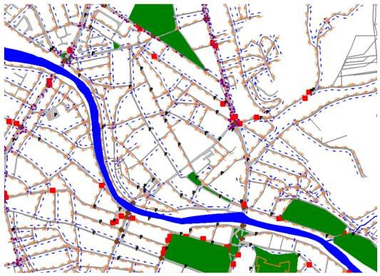
Application Areas of GIS
To plan a new transportation system

Slide 14
Application Areas of GIS
Mapping and navigation:
GIS is used to create maps and other spatial data products. This can be used for navigation, planning, and other purposes. For example, GIS can be used to create street maps, even underwater maps.
Environmental management:
GIS can be used to manage natural resources, track environmental changes, and plan for sustainable development. For example, GIS can be used to monitor deforestation, track wildlife populations, and plan for flood control.
Urban planning and transportation:
GIS can be used to plan and design cities, analyze traffic patterns, and plan for transportation systems. For example, GIS can be used to identify areas for development, plan new roads and transit lines, and track traffic congestion

Slide 15
Application Areas of GIS
GIS Disaster management:
can be used to assess the impact of disasters, plan for disaster response, and track recovery efforts. For example, GIS can be used to identify areas at risk of flooding, plan evacuation routes, and track the distribution of relief supplies
Business and marketing:
GIS can be used to analyze market share, target customers, and plan sales territories. For example, GIS can be used to track customer demographics, identify potential customers, and plan new store locations.
Health and human services:
GIS can be used to track disease outbreaks, plan for healthcare delivery, and manage public health resources. For example, GIS can be used to identify areas with high rates of disease, plan new hospitals and clinics, and track the distribution of vaccines.
❖
Tourism:
GIS can be used to plan and develop tourism destinations, market tourism products, and track tourist traffic. For example, GIS can be used to identify potential tourism destinations, plan new attractions, and track tourist spending.

Slide 16
Application Areas of GIS
Oil and gas:
GIS can be used to explore for and develop oil and gas resources, track pipelines, and manage environmental impact. For example, GIS can be used to identify potential oil and gas reserves, plan drilling operations, and track the impact of pipelines on the environment.
Astronomy:
GIS can be used to track the movement of celestial objects, plan astronomical observations, and study the impact of climate change on the Earth's atmosphere. For example, GIS can be used to track the movement of planets and stars, plan new observatories, and study the impact of climate change on the Earth's climate.
Banking and finance:
GIS can be used to analyze financial data, track assets, and manage risk. For example, GIS can be used to analyze mortgage foreclosure rates, track the movement of money, and manage the risk of fraud.

Slide 17
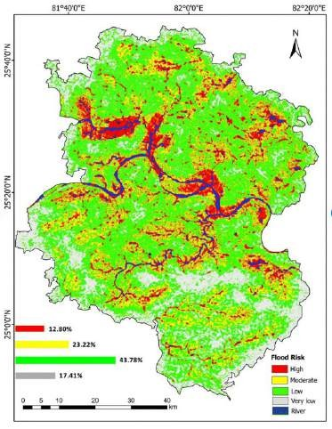
Disaster Management

Slide 18
Application Areas of GIS
Crime and defense:
GIS can be used to track crime trends, plan for law enforcement operations, and manage homeland security. For example, GIS can be used to identify areas with high crime rates, plan police patrols, and track the movement of terrorists.
Education:
GIS can be used to teach geography, environmental science, and other subjects. For example, GIS can be used to create interactive maps, conduct spatial analysis, and simulate real-world scenarios.
These are just a few of the many application areas of GIS. GIS is a powerful tool that can be used to solve a wide variety of problems. As GIS technology continues to develop, we can expect to see even more innovative and creative applications for this technology in the future.

Slide 19

Thank you

Slide 20
What Are the Components of GIS ?
Hardware b) Software c) Data D) method e) User
What kind of information can be described by the Spatial Data?
Ans: Locational Information
What Do you Mean by METADATA?
Ans: Data about data or information about data.
Define GIS as your own concept?
Briefly Discuss about the Application Area of GIS Field.
Home Work
What is the full form of TIN?
Ans: Triangulated Irregular Network

